Slide 1
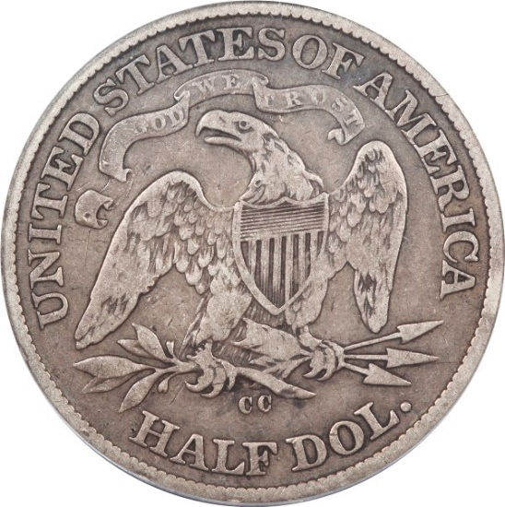
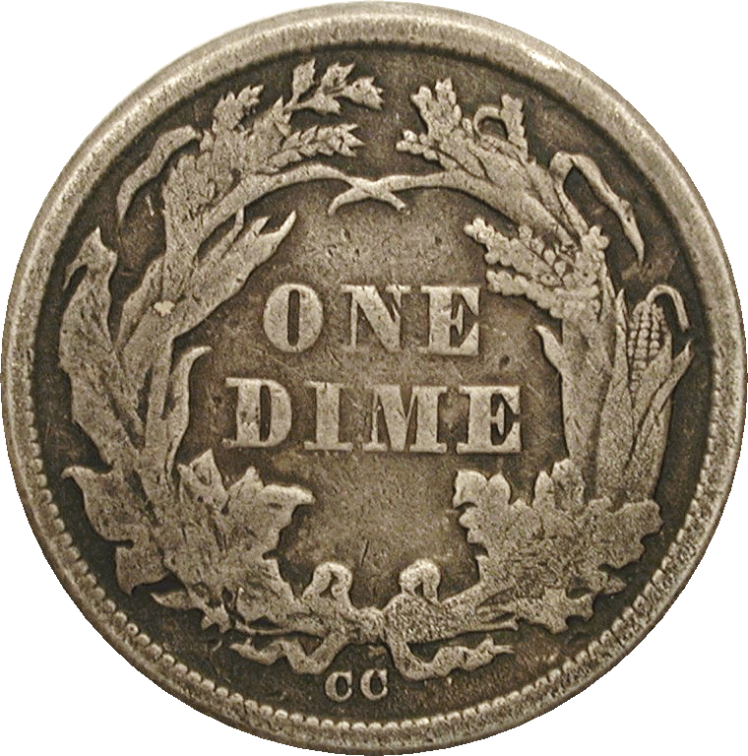
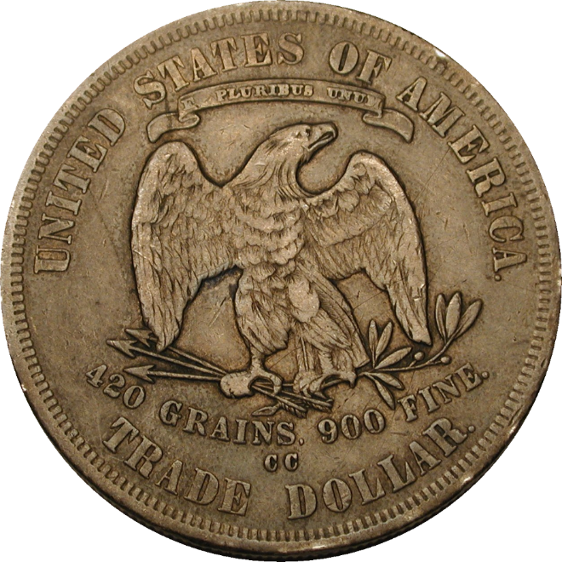
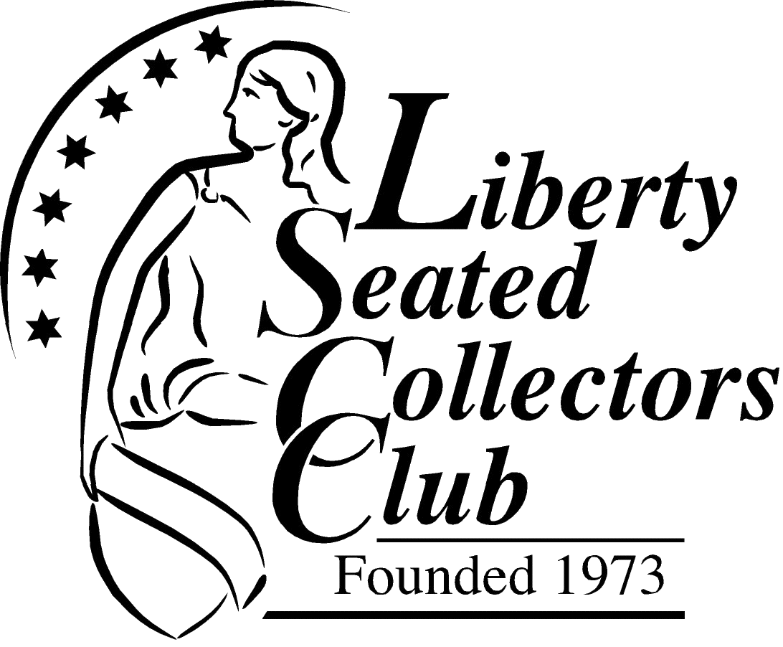
Carson City issues of Liberty Seated coinage

Slide 2
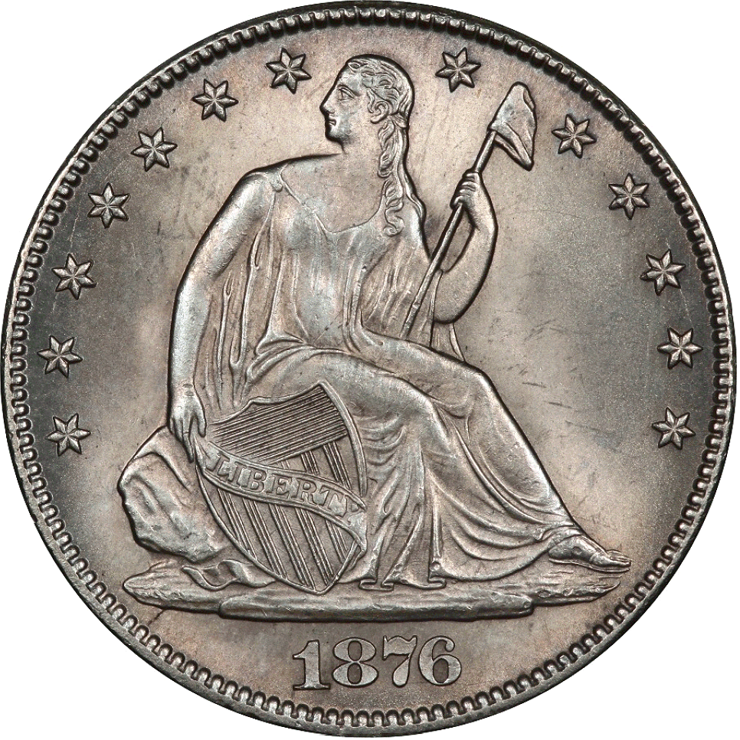
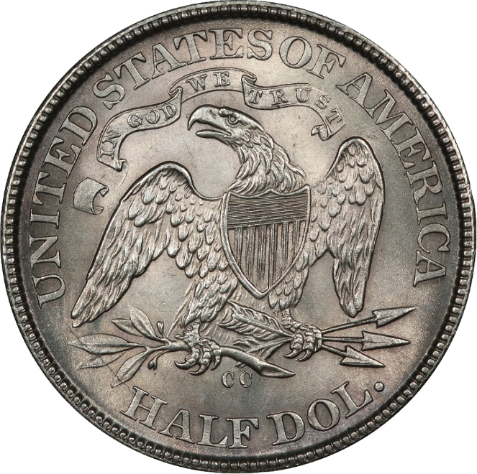
Carson City and Liberty Seated coins
Limited time span of 1870-1878
Dimes through Trade dollars
Half dimes not made at the Carson mint
After 1878, Carson City focused on Morgan dollars
Notes:
Carson City only made Liberty Seated coins from its opening in 1870 to 1878.
All of the Liberty Seated denominations were minted there except for Half Dimes
In 1878, silver coinage in Carson City was prioritized to the minting of Morgan Dollars, and after this, Morgans were the only silver coins made there until the Mint closed in 1893.

Slide 3
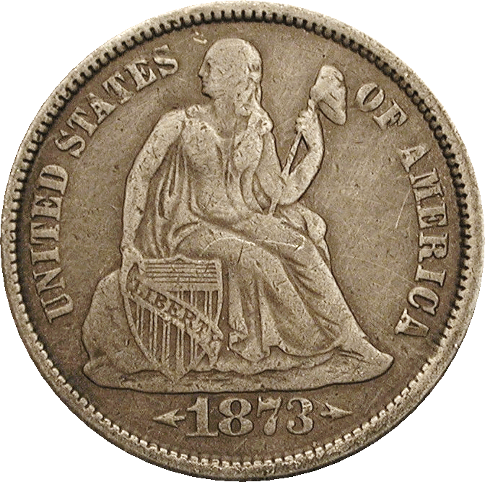
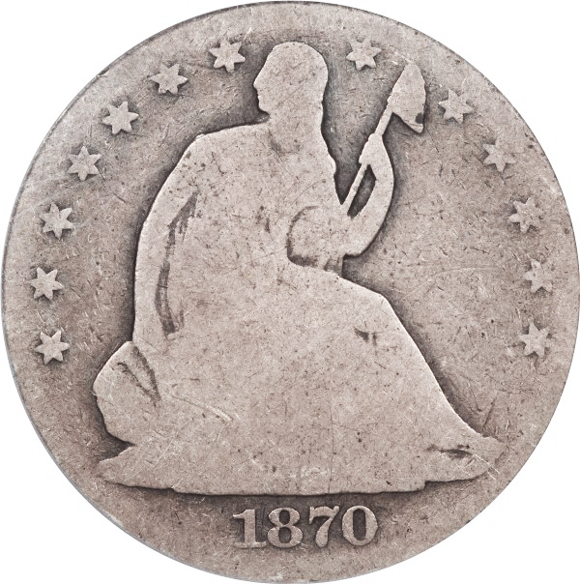
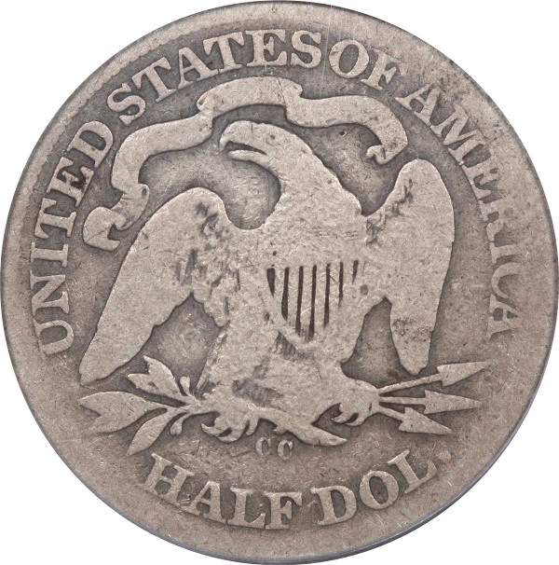
The early years
CC Mintages kept deliberately low for domestic coinage
  Politics! What else?
Many early CC coins are very scarce to very rare
Notes:
During the first few years of the Mint’s operations, the mintages were very low.
There were many politicians that did not want the Carson mint, and figured that they could spread doubt about the need for this facility. Therefore, they believed that paltry mintages would prove the Mint was not needed and result in its closure. 19th Centure politics at work!
Therefore, many of the initial issues are very scarce today, and some of them are some of our most legendary rarities.

Slide 4
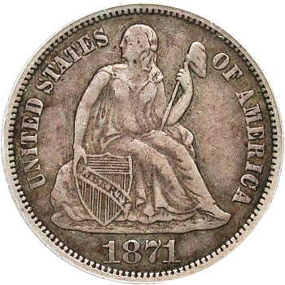
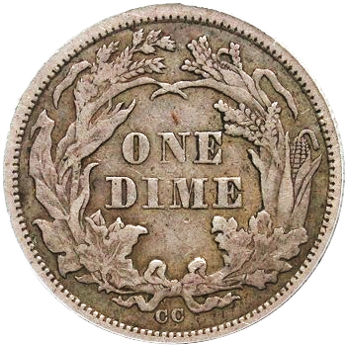
CC Dimes
Dime coinage in Carson began in 1871
Miniscule mintages through 1874
Production ramps up for 1875-1877
  These are readily available
Series ends with a scarce date in 1878
Notes:
Now, we’ll discuss each of the denominations of Liberty Seated coins struck in Carson City.
Carson City did not coin any dimes its first year. Dimes began production in 1871. As with other denominations (for reasons already mentioned), mintages were very low from 1871 through 1874. I872 was the highest of these at only a little over 35,000 coins.
Once it became clear the Mint would not be shut down, mintages of dimes rose in 1875, and for 3 years, mintages ranged between 4.6 and 8.2 million.
The series ends with a scarce issue, as only 200,000 1878-CC dimes were coined before production halted in favor or Morgan dollars.

Slide 5
Carson City Key Dates
1874-CC, 1871-CC, 1873-CC, 1872-CC in rarity order
Low survival rate due to heavy circulation
Many surviving examples are metal detector finds with multiple problems
  Porosity (environmental damage), scratches
  Many are repaired, re-toned and third-party graded as “market acceptable”
Choice original examples are extremely rare
Notes:
The early 1871-CC to 1874-CC are the rare dates. The 1874-CC is the rarest of these, and is considered the key date of the entire regular issues Liberty Seated Dime series. The 1871-CC is second in rarity, followed by 1873-CC. The 1872-CC is the least rare (but certainly very scarce in its own right)
The early dimes circulated heavily, and they have a very low survival rate, resulting in few examples available to collectors.
Many of the known examples of these early dates are metal detector finds, and have numerous and severe problems.
Most show some level of porosity and scratches from their time in the ground (and their recovery). And many of the coins have been repaired, cleaned, and retoned. And a good number of these problem coins have been graded for 3rd-party grading companies as “market acceptable.”
Finding a truly problem-free example of any of the 1871-1874-CC dates is very difficult as they are extremely rare

Slide 6
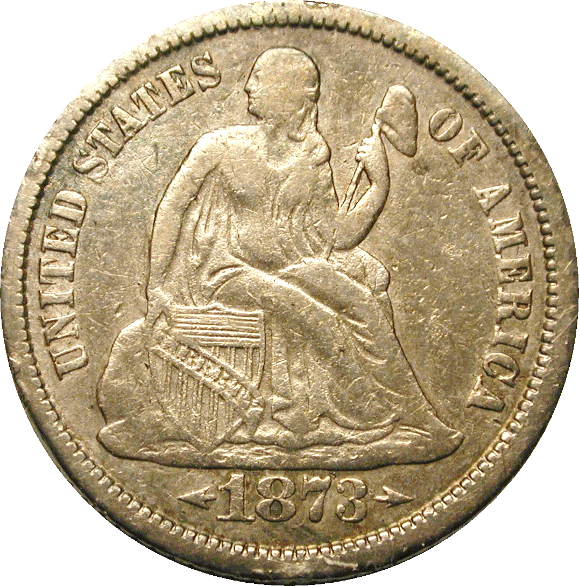
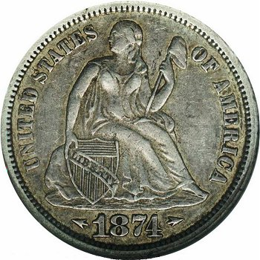
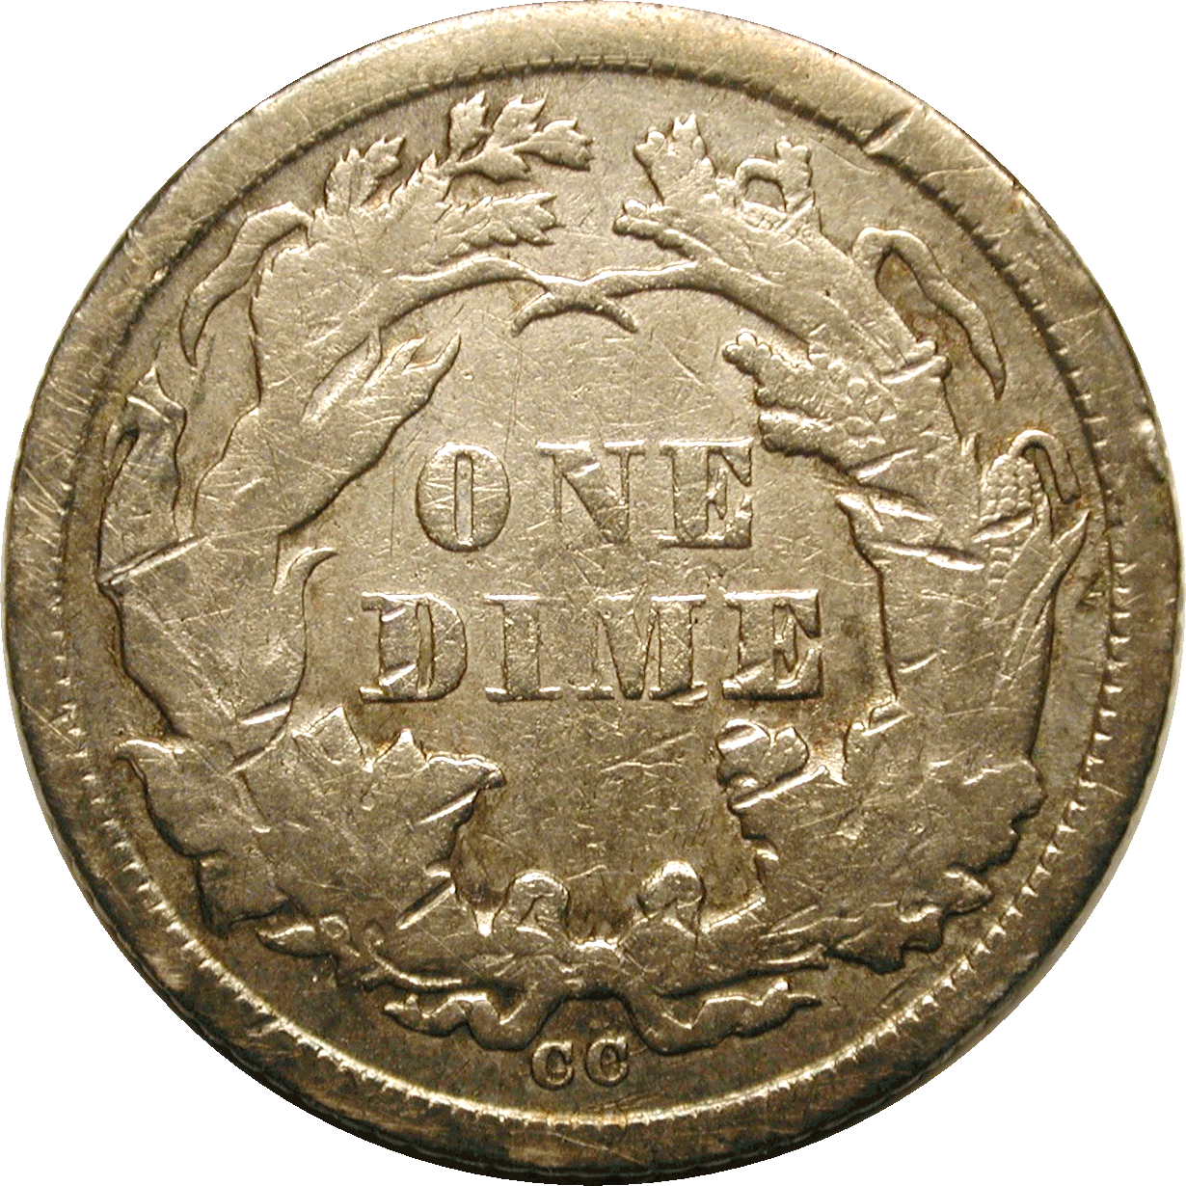
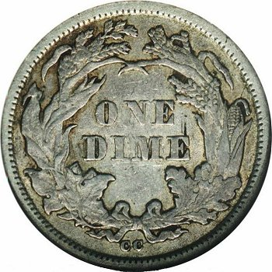
Typical vs. Choice for the early dates
Notes:
These photos exhibit the differences between typical and choice examples.
The coin on the left is rather banged up from circulation, but actually has less surface problems and porosity than commonly seen. Many are worse than this one.
The coin on the right has exceptional surfaces, and is one of the very few choice examples known in higher circulated grades.

Slide 7
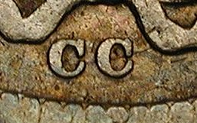
Early CC dimes
1871-CC, 1872-CC, 1873-CC, and 1874-CC all used the same reverse die
Die crack developed at mintmark in mid-1872
Most 1872 and all 1873-1874 CC coins should have it
Added mintmarks will not match the mintmark below
Notes:
There are numerous altered coins posing as the rare early dates. Most of them come from adding the CC mintmark to Philadelphia coins. To help detect these, it is a convenient fact that a single reverse die was used to produced all of the CC dimes from 1871 to 1874. Any purported example should have the mintmark pictured here, and if it doesn’t, it is a forgery.
In addition, the reverse die developed a die crack at the mintmark during the year 1872. As a result, most 1872 coins, and all 1873 and 1874 coins have this die crack. Sometimes corroded or repaired coins may have surfaces that make the die crack difficult to see.
However, coins with an added mintmark will not exactly match the mintmark pictured here.

Slide 8
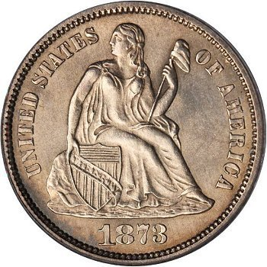
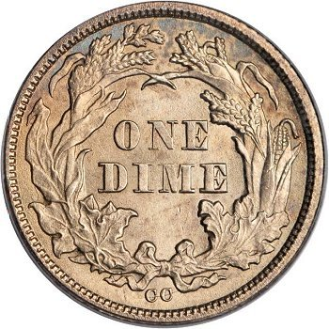
Uncollectable – 1873-CC No Arrows
PCGS MS65
Photos courtesy Stack’s Bowers
Notes:
The most famous of all Liberty Seated dimes is the 1873-CC No Arrows. Believed by many to be one of the Assay coins, it is the only example known.
Unique, this coin is one of the most sought-after coins in the entire U.S. series, and is a news event when it comes on the market.
It last sold in 2012 for over $1.8 million.

Slide 9
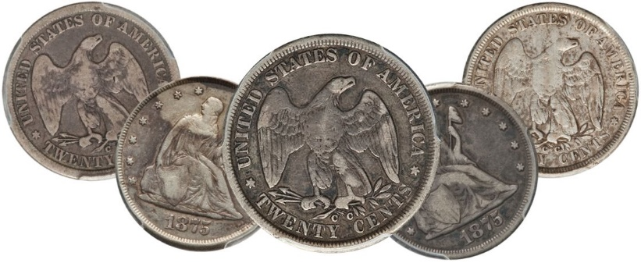
CC Double Dimes
Series began in 1875
Only coined for circulation in 1875 and 1876
1875-CC is common (only behind 1875-S) and overrated
1876-CC coins never needed and most were melted
Notes:
The twenty-cent piece, or Double Dime, did not make its appearance until 1875. Because the so-called demand was in the western part of the country, San Francisco and Carson City produced the vast majority of them. In Carson City, this denomination was struck both years that the coin was minted for circulation.
The 1875-CC issue is common, as 133,290 was plenty to meet demand, and then some. There are thousands of pieces available from a scarcity perspective, the issue is overrated in all grades up to XF.
On the other hand, the 1876-CC was not needed when it was minted, and almost the entire production run was melted.

Slide 10
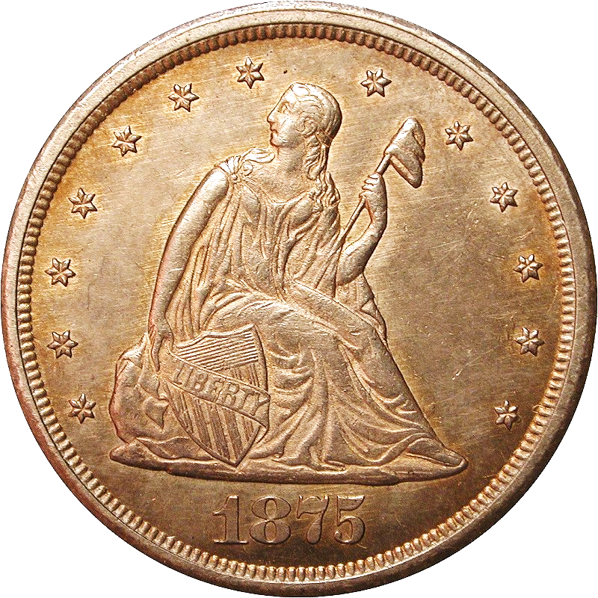
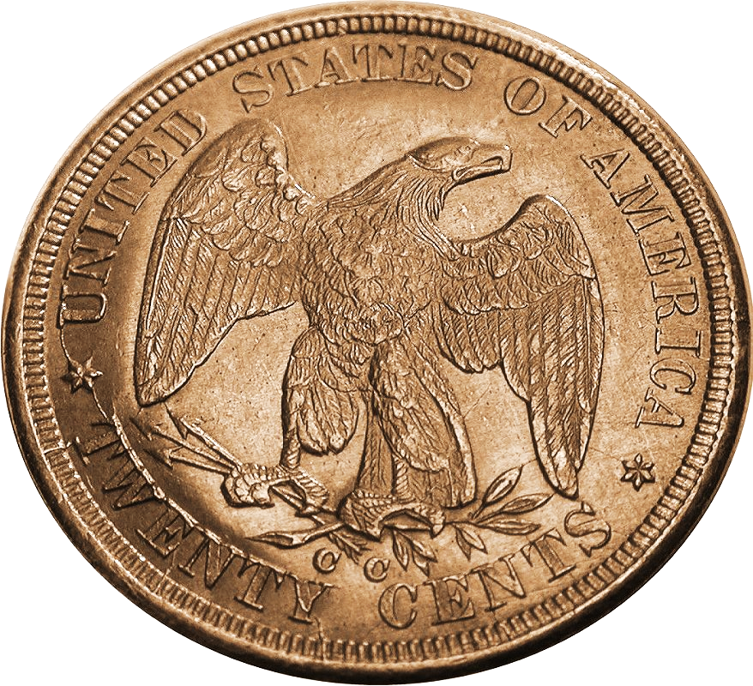
1875-CC
5 known die marriages
  One represents 75% of the known examples
  Another about 20%
  Another less than 5%
  One rare (presently 17 known)
  And one has only 2 known!
Notes:
Extensive study of this date has revealed five different die marriages (combinations of obverse and reverse dies). Two die marriages account for the vast majority of known examples. A third is scarce, and two others are quite rare.
With the availability of a comprehensive reference, some variety enthusiasts are actively seeking out the rare ones.

Slide 11
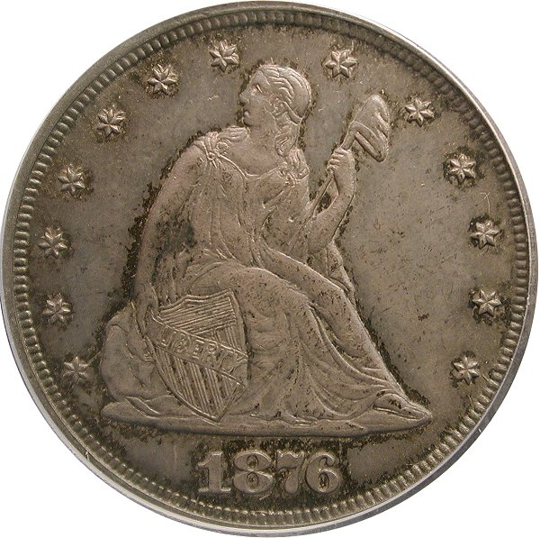
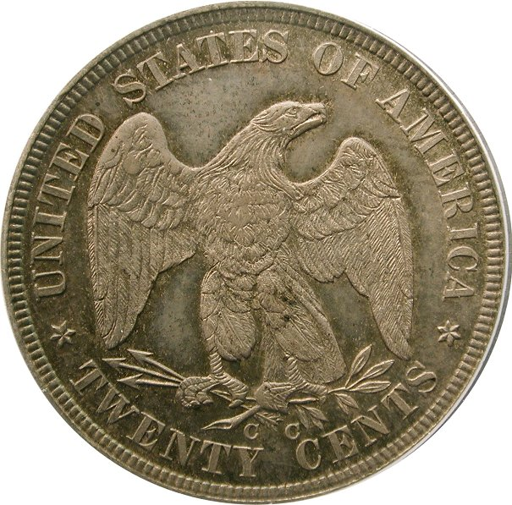
The legendary 1876-CC
One of our most famous rarities
Often thought of with the 1804 Dollar, 1894-S Dime, and other notables, with only 19 examples confirmed
With a mintage of 10,000, how did this happen?
Notes:
Despite this being a very short series, there is one major rarity from Carson City.
The legendary 1876-CC twenty-cent piece, often spoken about with the likes of the 1804 dollar and 1894-S dime, didn’t start out as an extreme rarity. 10,000 were initially ordered and minted, and while not a hefty mintage, it was respectable.
However, since several thousand unissued 1875-CC coins were still on-hand, and demand had slowed to a crawl, these new 1876 coins were never released.
However, some of these new coins were purchased as souvenirs, keepsakes for the new year, or perhaps saved by people who believed the denomination wouldn’t last. Perhaps a couple of coins for assay purposes were also set aside.
Regardless, these are the only coins that left the mint, and in 1877, the Superintendent of the Mint was ordered to melt any twenty-cent pieces still on hand, which included nearly the entire production run of 1876-CC.
As a result, fewer than 20 are known today.

Slide 12
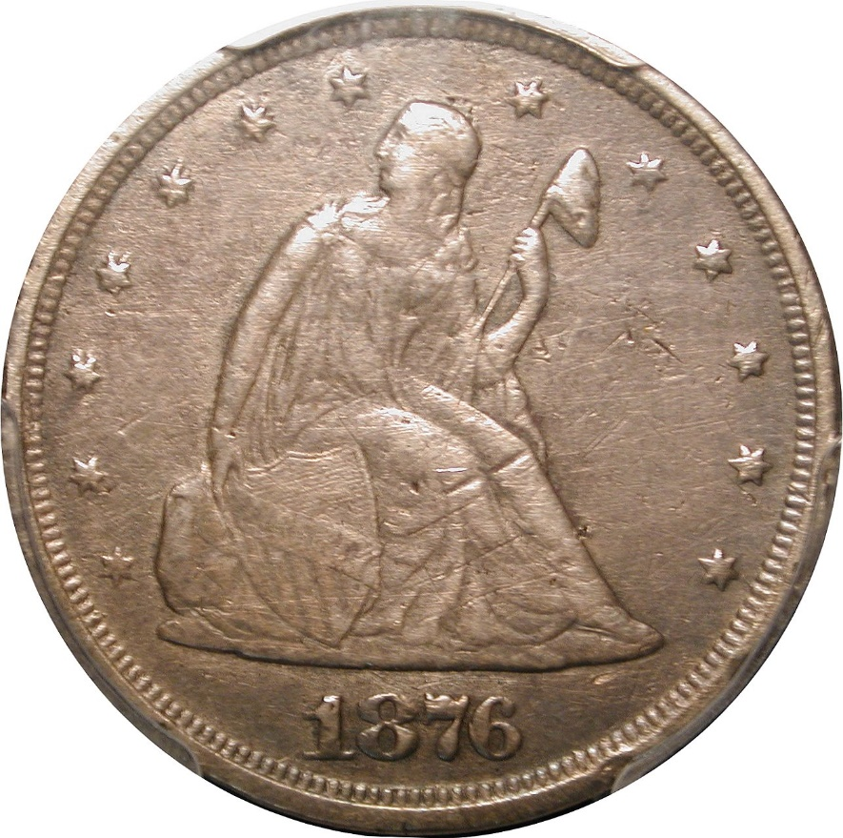
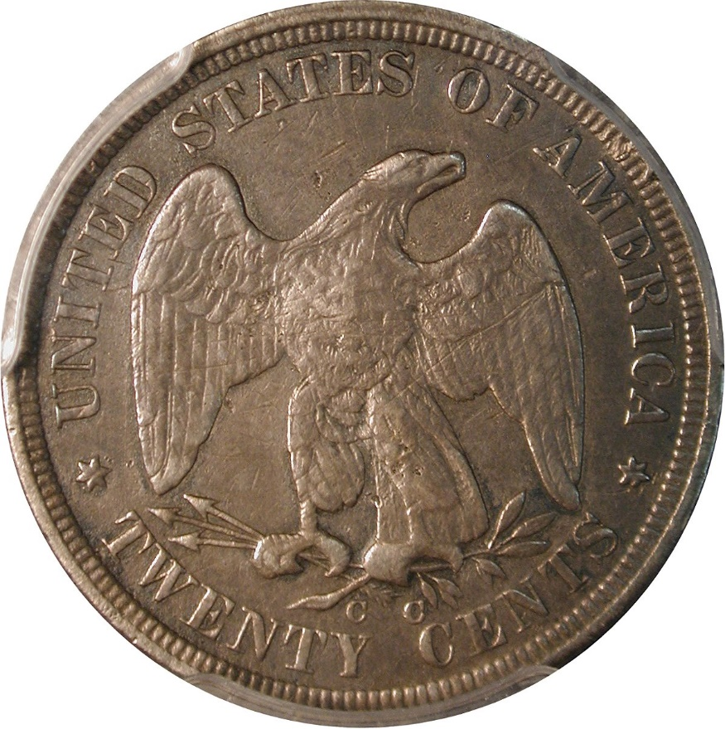
The legendary 1876-CC
Circulated examples prohibitively rare
Just 3-4 known circulated examples
The E.A. Carson Specimen – XF, scratched and polished
Notes:
Being saved as keepsakes, the vast majority of 1876-CC Double Dimes are in mint state, and circulated examples are extremely rare. With just 3-4 worn examples known, even this piece, which is scratched, tooled, and polished, is a highly-prized example.

Slide 13
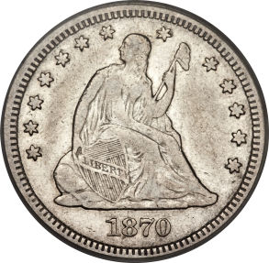
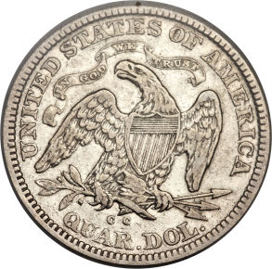
CC Quarters
Basic info similar to dimes
Mintages 1870-1873 very low and all are rare
  About 75 known of 1870, 1871, and 1873 issues
None made in 1874
Mintages increase 1875-1878
  Especially so in 1876 and 1877
First focus in any Seated Quarter set appraisal will be early CCs
Notes:
Carson City quarters follow along most of the history of the dimes.
Like the dimes, mintages in the early years were very low. The coinage of quarters did begin in 1870, but none were minted in 1874.
Mintages did increase in 1875 to 140,000, but really took off in 1876 and 1877, when more than 4 million were coined each year.
When somebody examines a collection of Liberty Seated quarters, the first focus is usually on the early CCs, and this is often the first impression on the appraisal of the set.

Slide 14
Early Carson City issues
Considerably controversy in ranking the 1870-CC, 1871-CC, and 1873-CC for rarity
1870-CC has traditionally been priced higher, likely owing to the mintage figures:
  1870-CC 8,340 PCGS pop: 56
  1871-CC 10,890 PCGS pop: 42
  1873-CC 12,462 PCGS pop: 52
Personal experience of most experts ranks the 1871-CC as the most difficult in terms of market availability
Choice examples of any are few and far between
Notes:
There is some debate as to which of the early issues is rarest, and each of the 1870-CC, 1871-CC, and 1873-CC have a claim.
Traditionally the 1870-CC is priced higher, as it is the first year and also the lowest of the three mintages. However these examples also appear more often at auction.
When looking at both population reports and the experience of Liberty Seated Quarter experts, it is the 1871-CC that usually has the lowest population at any random point in time. Also, regardless of which is truly rarest, it is the 1871-CC that appears least often in the marketplace.
Like with the Dimes, these early CC quarters are usually impaired in some way and choice examples are rare.

Slide 15
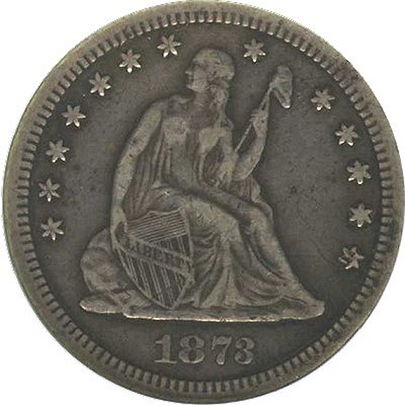
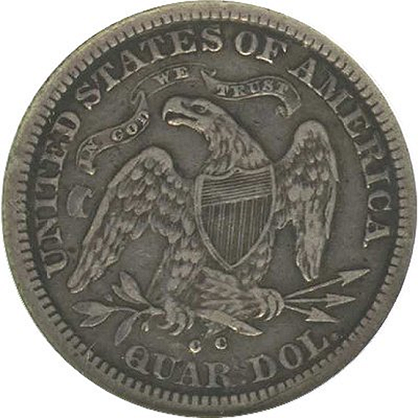
1873-CC No Arrows – Uncollectable
Only 5 known
3 of these are Mint State
Notes:
The CC Quarters series has its own version of an uncollectable issue. Like the dime, most of the 1873-CC No Arrows coins were melted unreleased, and only 5 examples are known. Of the 5, three are in mint state, and only two are circulated. The example show grades XF.

Slide 16
CC Half Dollars
Same 1870-1878 date range
Scarce coins are the early dates, plus 1878-CC
  1870-CC mintage: 54,617
  1874-CC mintage: 59,000
  1878-CC mintage: 62,000
High mintages 1875-1877
  All over 1 million
Notes:
Carson City halves were minted every year in the 1870-1878 date range. Mintages in the early years were much higher than dimes or quarters.
The lowest mintage was in 1870, and it is the scarcest of the CC issues. Other low mintages include 1874 and 1878.
Like the other denominations, production was highest in 1875-1877 with over 1 million coined each year.

Slide 17
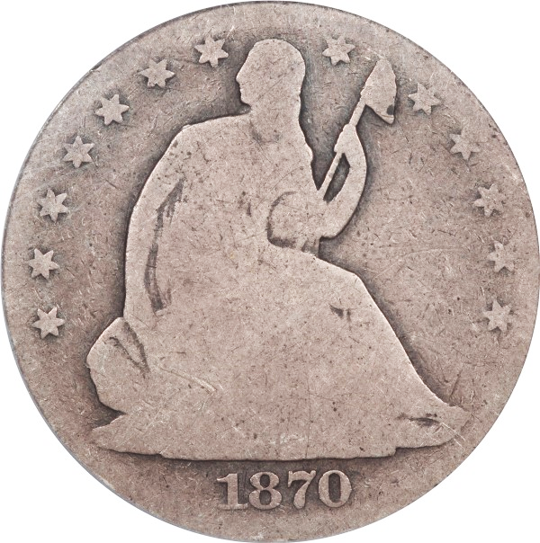
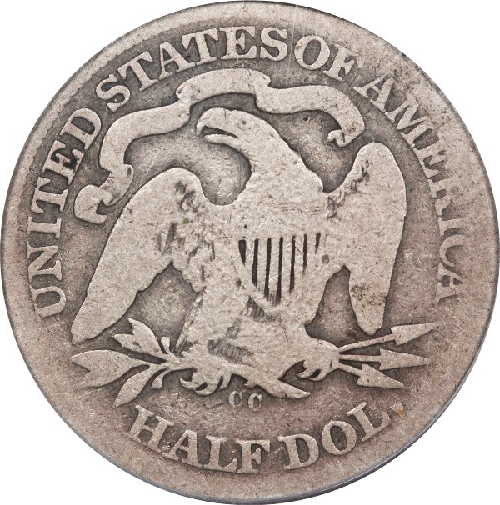
CC Half Dollars
Rarest dates:
  1870-CC (~200 known)
  1878-CC (~250)
  1874-CC (~300)
  1873-CC No Arrows (~500)
1871-CC possibly the most underrated
Notes:
While there are no show-stoppers, four issues present a challenge. The 1870-CC is scarcest, with only about 200 known in all grades.
1878-CC often gets overlooked, but it is second in scarcity, followed by the more popular 1874-CC Arrows issue. Finally, despite a mintage of over 200,000, the 1873-CC No Arrows has only about 500 survivors.
Overshadowed by the scarce first-year issue, the 1871-CC is perhaps the most underrated of all CC halves and is surprisingly tough to find nice.

Slide 18
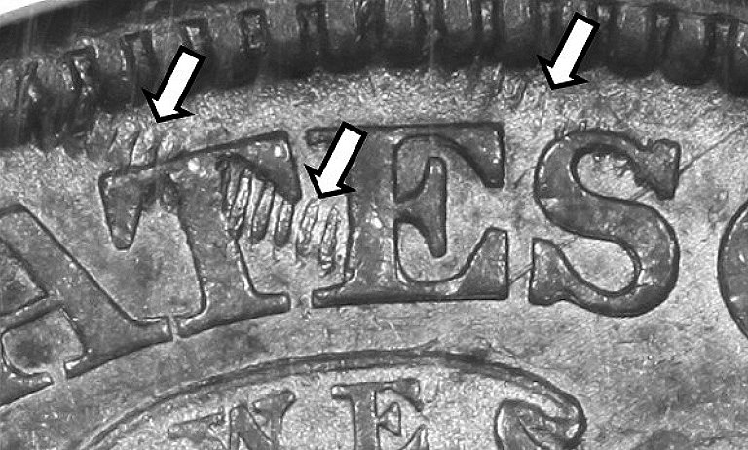
1874-CC “Railroad Track Reverse”
1 major die state of a very scarce coin!
Mostly in low grades
30-40 known, and more to be discovered?
Notes:
Of the scarce issues, there is one significant variety, which is actually a die state. An 1874-CC reverse became damaged with reeding marks and has been given the designation “Railroad Track Reverse.” There are presently about 30-40 known out of the ~300 survivors, and as a few of these have been found recently, there are likely a few more yet to be found.

Slide 19
1877-CC Half Dollars
2 reverse hubs (transition year)
Notes:
There are two minor reverse hubs known for the Liberty Seated Half, and 1877 was the transition year.
The key differentiator for the hubs is the number of buds to the left of the eagle’s claw. The first hub, with a split bud is rare, and the vast majority of 1877-CC coins feature the second hub, with a closed bud.

Slide 20
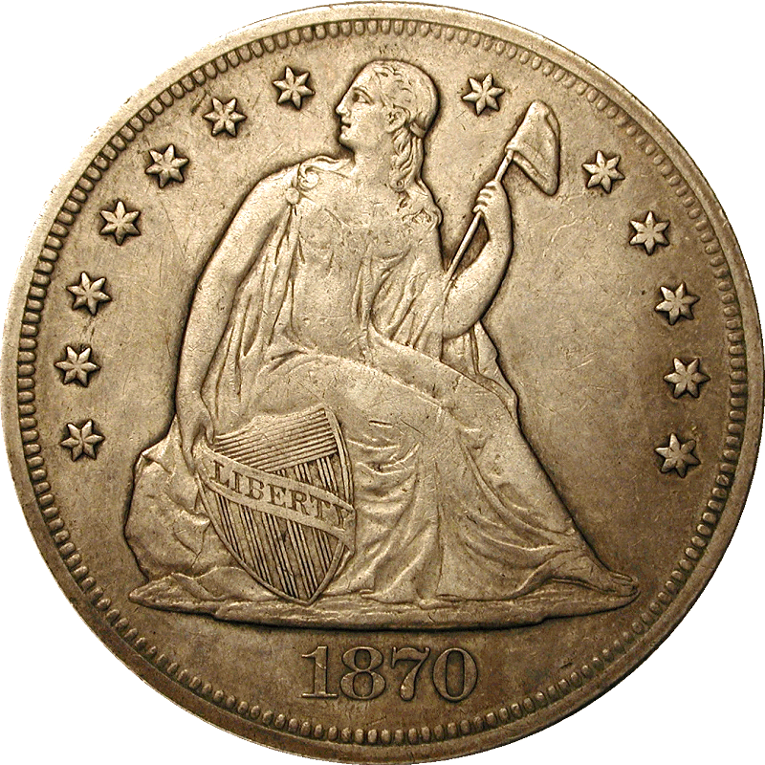
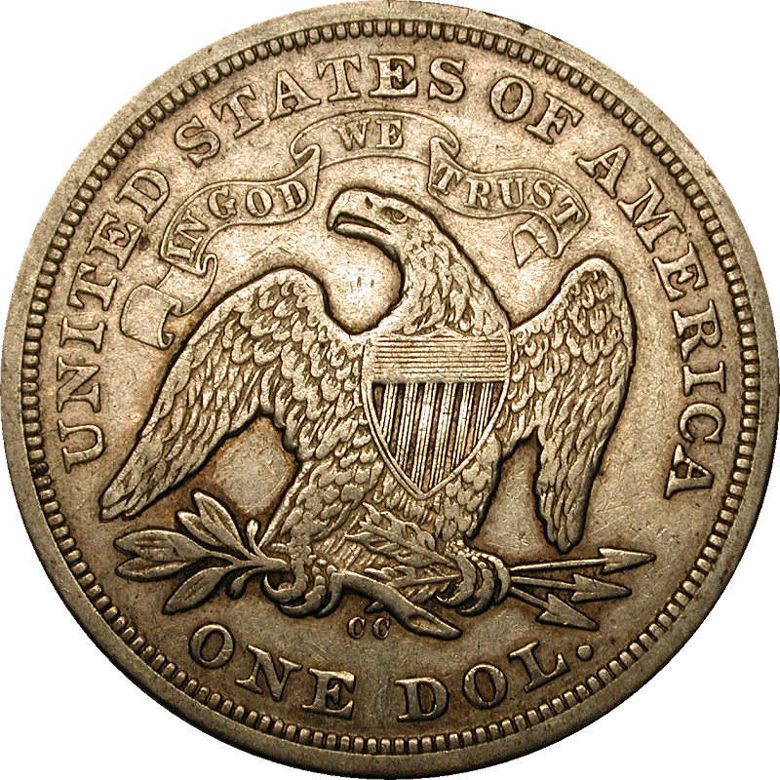
Carson City dollars
Just a little tougher than the GSA Carson City Morgans ☺
Minted just four years – 1870-1873
1870-CC is the only one readily available
  Unlike all the other denominations!
Notes:
Now on to Carson City Dollars.
With a big smile, it is safe to say that CC Seated Dollars are “just a little tougher” than the millions of mint state CC Morgan Dollars released from the Treasury vaults.
Liberty Seated Dollars were coined in Carson City beginning in 1870, until the denomination was abolished in 1873.
Unlike the other series (where the 1870-CC was rare and one of the least available), the opposite is true for the Dollars.
The 1870-CC had the highest mintage of the four, and also the highest survivorship. It is also under intense pressure from type collectors wishing an example of Seated Dollar from each mint.

Slide 21
Extraordinarily low mintages after 1870
1870-CC 11,758
1871-CC 1,376
1872-CC 3,150
1873-CC 2,300***
*** Likely more than half of the 1873-CC coins melted before
release by the Mint when Trade dollar was introduced
Notes:
After a relatively small initial mintage in 1870, the production of Dollars fall off dramatically in subsequent years, resulting in some very scarce issues for collectors to obtain.

Slide 22
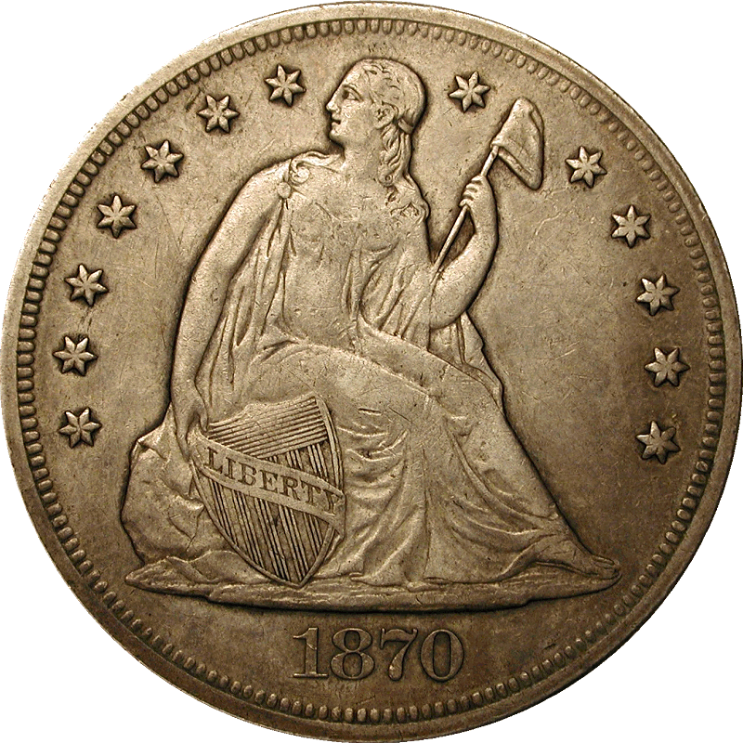
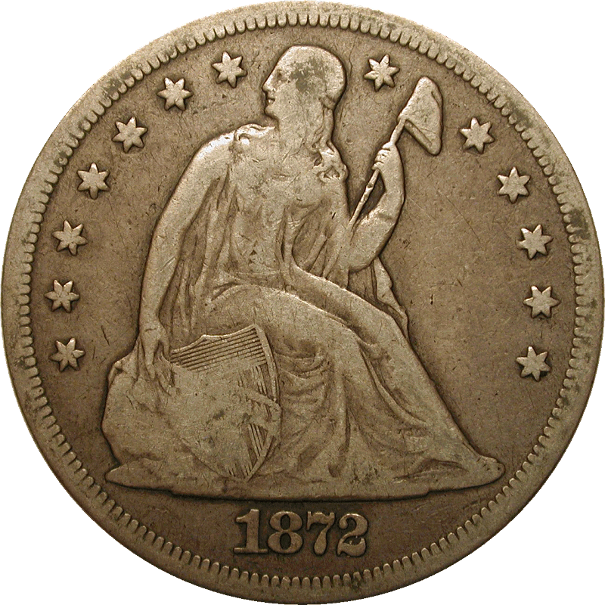
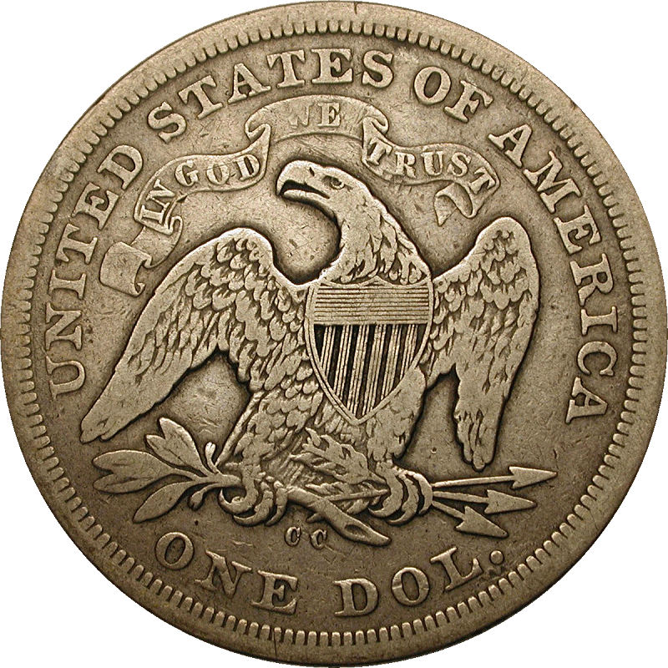
Carson City issues
1870-CC is the most available issue – very high demand
1872-CC has been more available in the last 5 years
  Vast majority of these recent examples are impaired
Notes:
As mentioned earlier, the 1870-CC is the most available of the CC Seated Dollars, and it is in very high demand by type collectors.
The 1872-CC is a very scarce coin, but numerous examples have come on the market in the past few years, although most of these are cleaned, damages, or impaired in some way. Finding a nice 1872-CC is as difficult as ever.

Slide 23
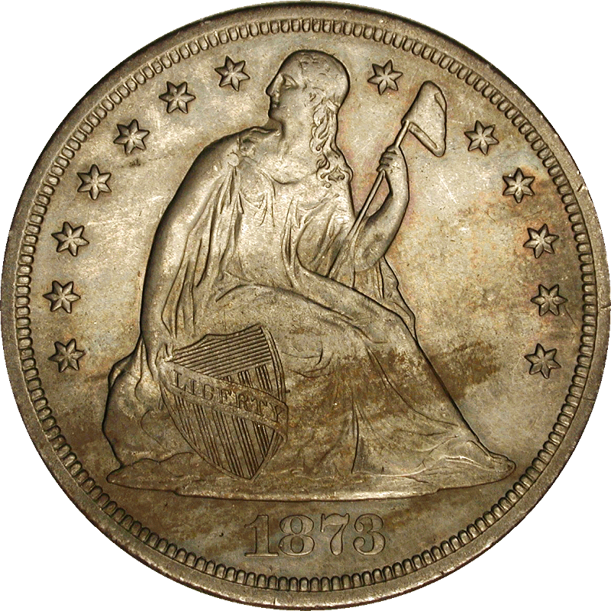
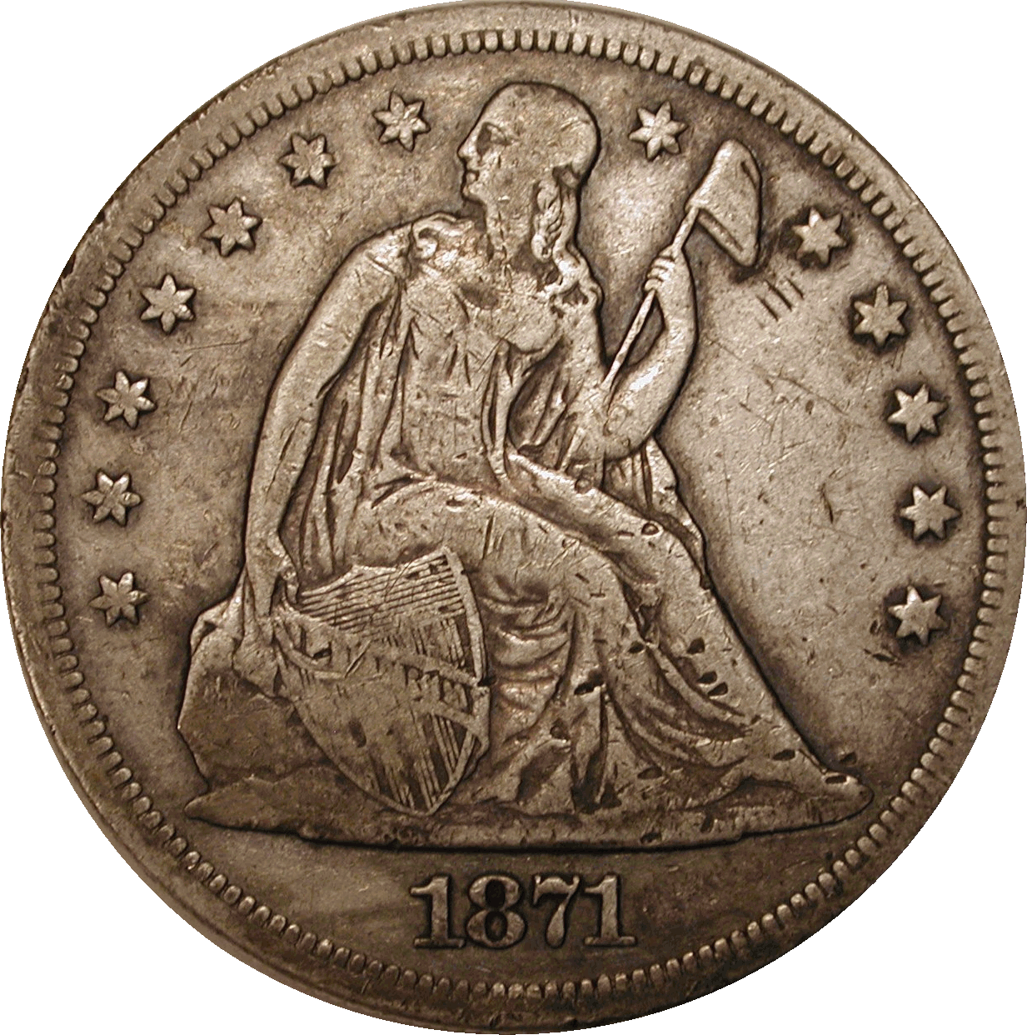
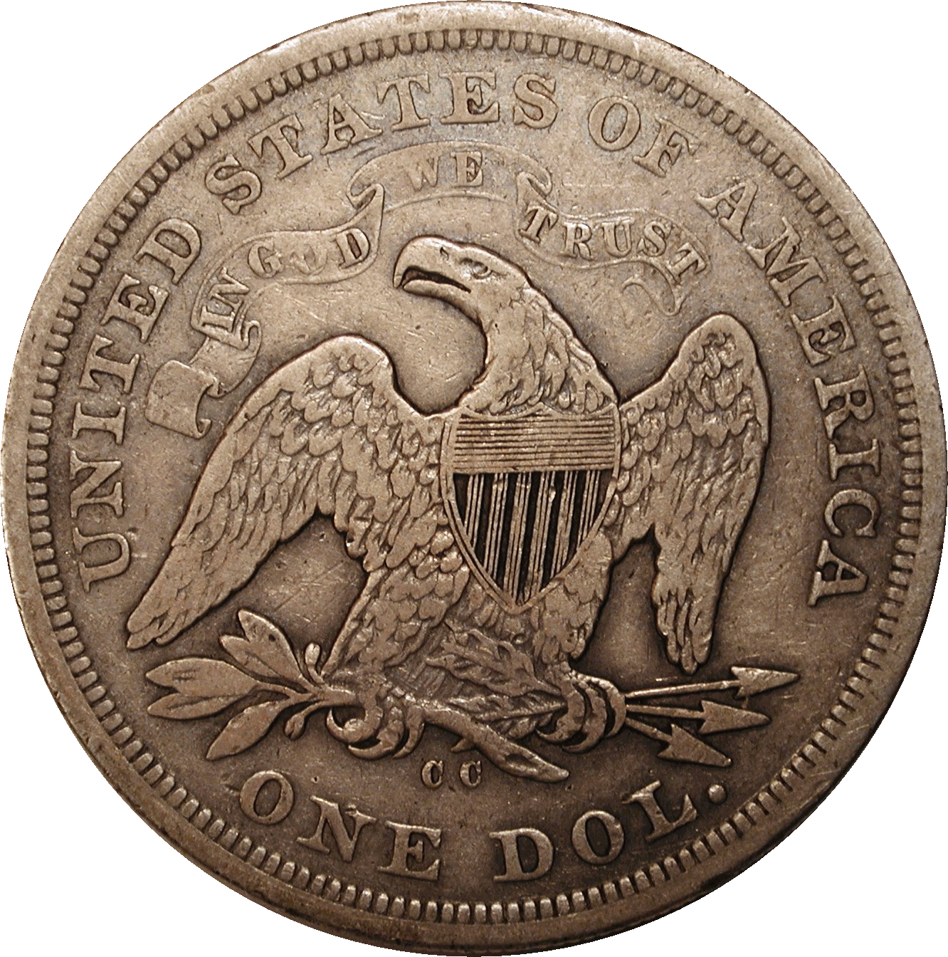
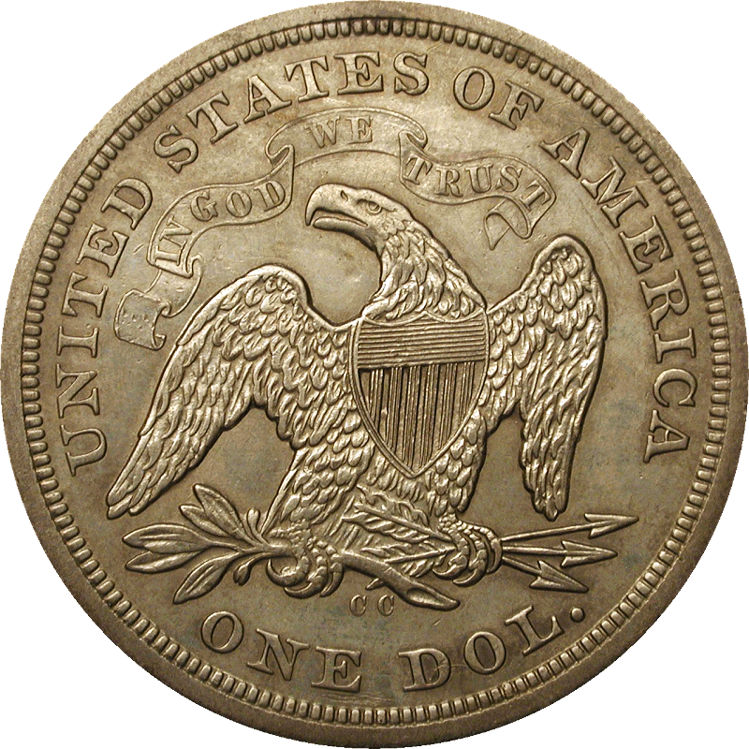
Carson City issues
1871-CC and 1873-CC are very scarce
Problem-free examples fairly rare
1871-CC (150-175 known)
1873-CC (100-125 known)
Notes:
The two rarest of the CC dollars are the 1871-CC and 1873-CC. Even though the 1873-CC has a higher mintage, it is likely more than half never left the mint and were melted to coin Trade Dollars. Regardless, only about 100 of the 1871-CC and 80 or so 1873-CC remain available for collectors.

Slide 24
Studying the 1870-CC
1871-CC, 1872-CC, 1873-CC single die marriage each
1870-CC has nine different die marriages known
Remarkable for a coin with mintage of less than 12,000!
Records show it was made in 11 distinct batches
Notes:
Carson City Seated Dollars have been the subject of extensive study. Each of the low-mintage years was struck by a single die marriage.
Not so with the 1870-CC. 9 different die marriages are known for a total output of less than 12,000 coins! Records have been found that show the 1870-CC production occurred in 11 small batches throughout the year, where a pair of dies would have been taken off the shelf for use each time, resulting in so many die marriages. 4 obverse dies and 6 reverse dies were use.
It should be noted that each of the 1871-CC, 1872-CC, and 1873-CC used one of the existing 1870-CC reverses rather than new dies.

Slide 25
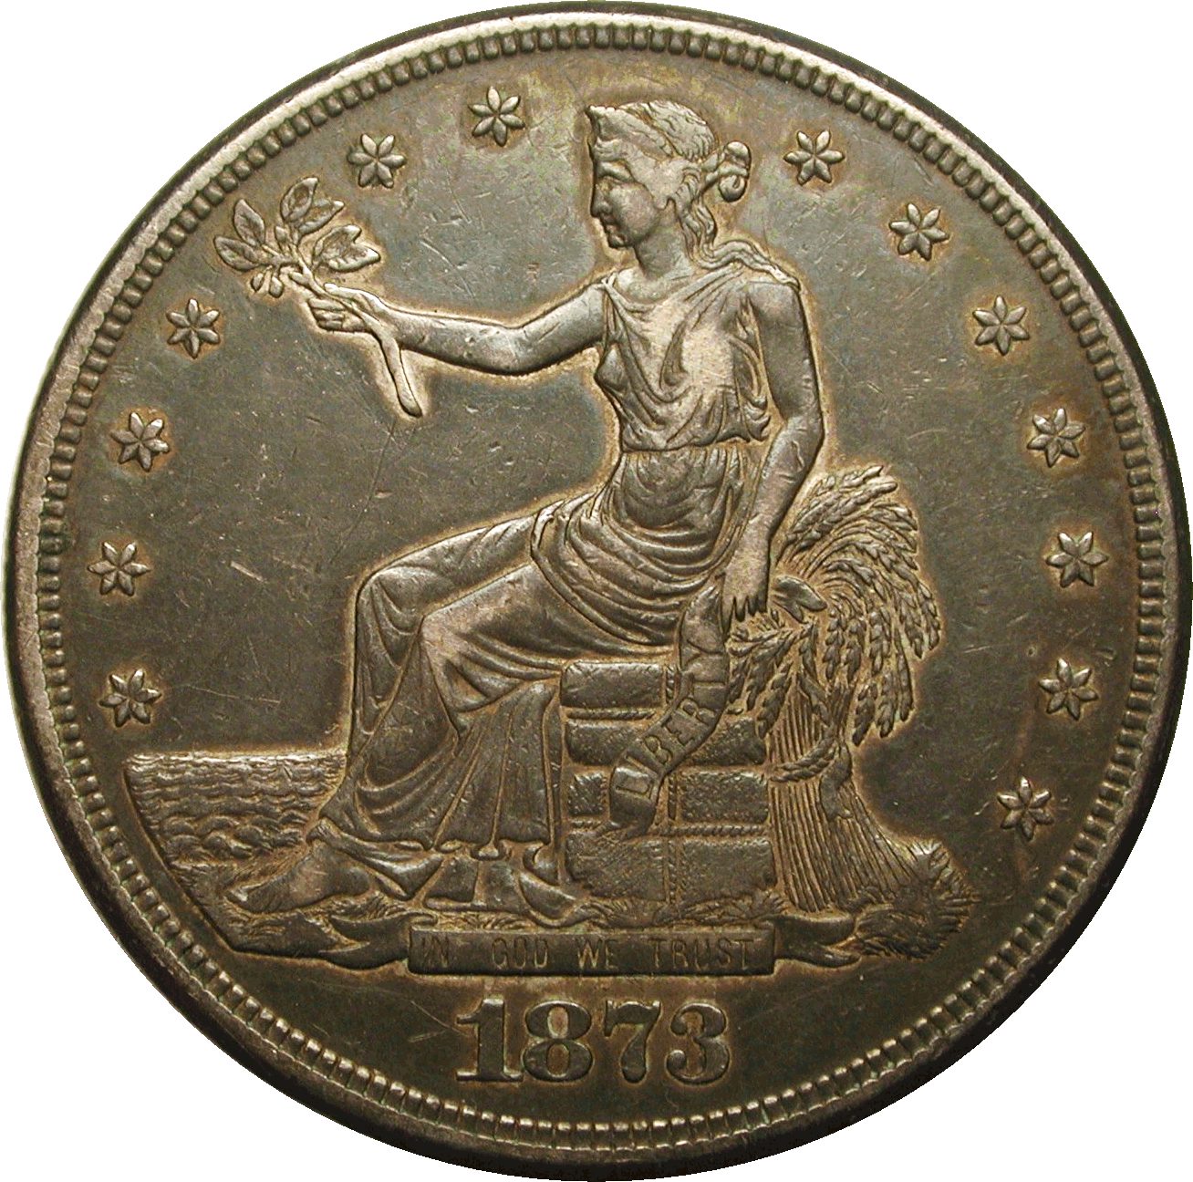
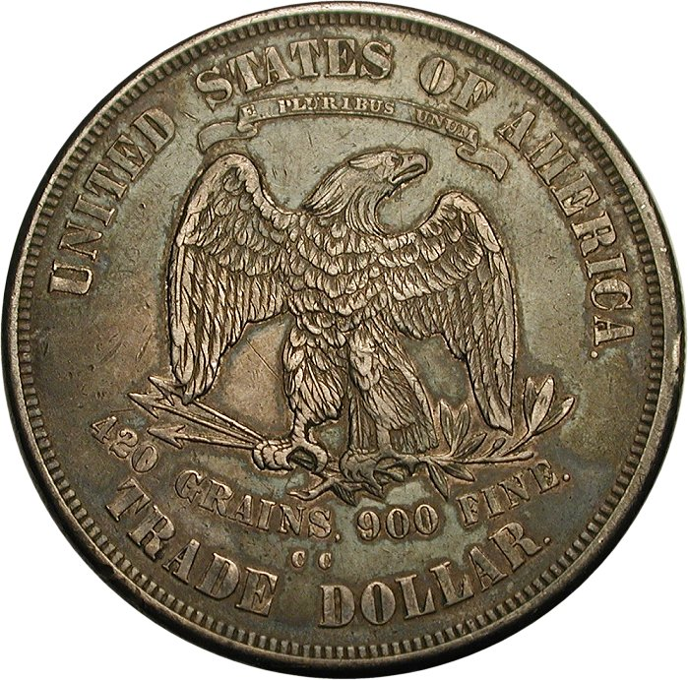
CC Trade dollars
Minted 1873-1878
  Introduced when the Liberty Seated Dollar was abolished
Primarily for foreign trade as bullion coins
Low mintage start in 1873, increased beginning 1874
Carson City issues end with the key date 1878-CC
Notes:
In 1873, the standard silver dollar was abolished and the Trade dollar was introduced. Carson City minted Trade Dollars every year the denomination was struck for circulation, 1873-1878.
The Trade Dollar was primarily intended for foreign trade use as bullion coins, and was slightly heavier than the former silver dollars.
The initial offering in 1873 had a modest mintage of 124,500, but it ramped up to over 1 million for 1874. From 1875-1877, Trade Dollar production was plentiful.
The final CC issue in 1878-CC is the key date of the entire Trade Dollar series.

Slide 26
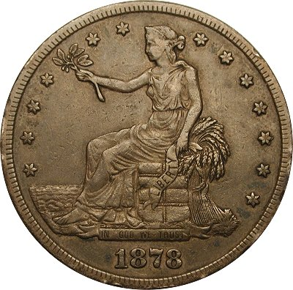
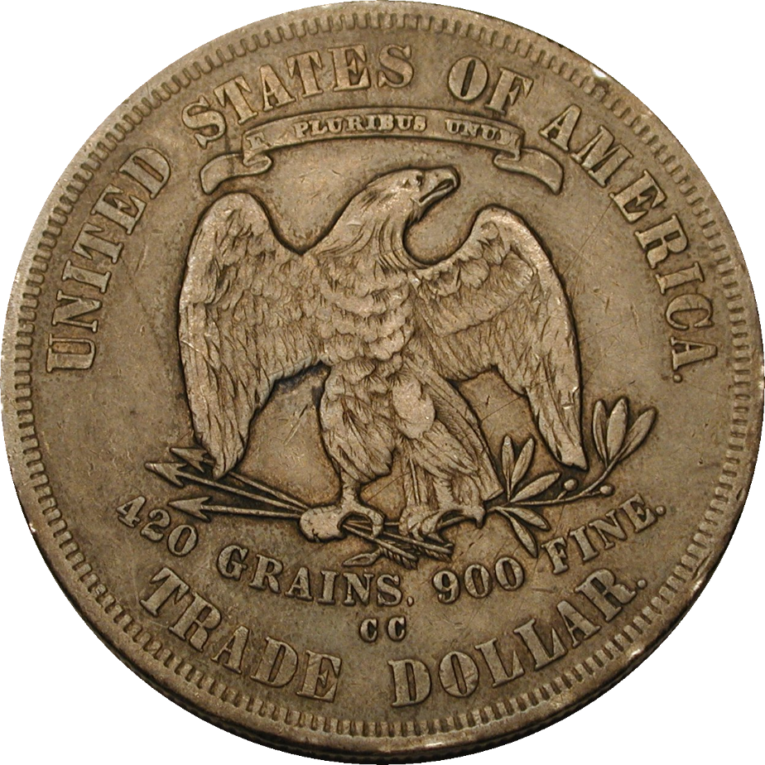
Key date – 1878-CC
Low mintage, 97,000, and many melted unreleased
Scarce in all grades, scarcer than the proof-only issues
Notes:
The 1878-CC had a series-low business strike mintage of 97,000, but more than half of these were melted after production was halted for the newly-authorized Morgan Dollar.
This resulted in a key date for the series, and this issue is scarcer than any of the proof-only dates from 1879 to 1883. Nice 1878-CC Trade Dollars are real prizes.

Slide 27
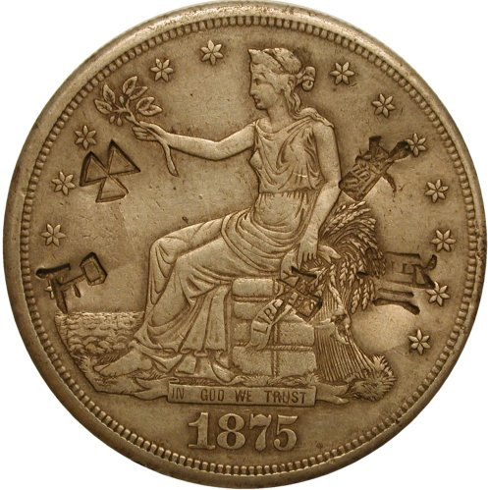
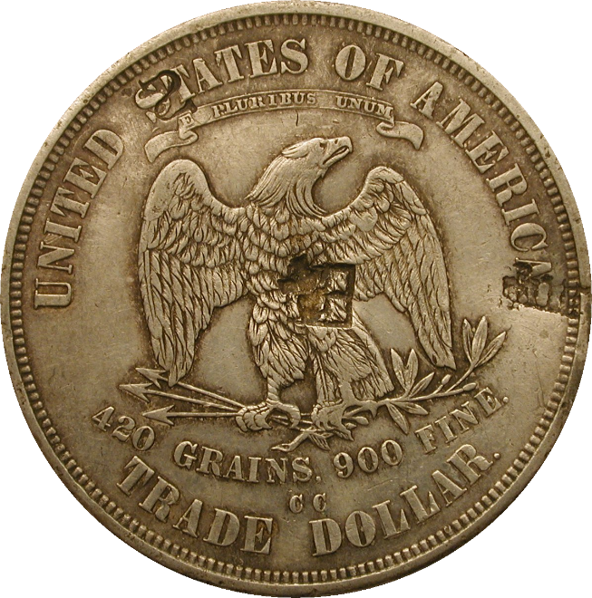
Chop marks
Chop marks often applied to Trade dollars by merchants
  To certify acceptance for silver weight and fineness
  Often Chinese characters
  Sometimes one, sometimes many chop marks
Chop marks are considered damage, but highly collected
All CC issues known with chop marks – 1878-CC rarest!
Notes:
Many Trade Dollars that saw commercial use in the Orient can be found with counterstamps, called chop marks. Chop marks are often featuring Chinese characters, often representing a word or even a business name. Some coins have a single chop mark, and others have several to many.
Chop marks were imparted by people or businesses that accepted the coin, to certify that the individual/business had deemed the coin was of proper weight and fineness.
While chop marks are considered damage, it is not considered the same type of damage that other coins suffer from time to time. Chop marks are accepted by many collectors as they were the normal result of the type of commerce intended for these coins. They are widely collected. For many years, the price discount for chop marked coins was huge, but in recent years, this discount has been drastically reduced.
All business strike issues are known with chop marks, but the rarest dates with chop marks are 1878-CC (first) and 1875-P (second).

Slide 28
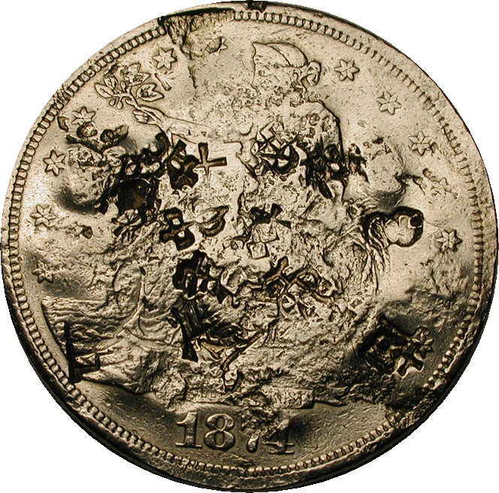
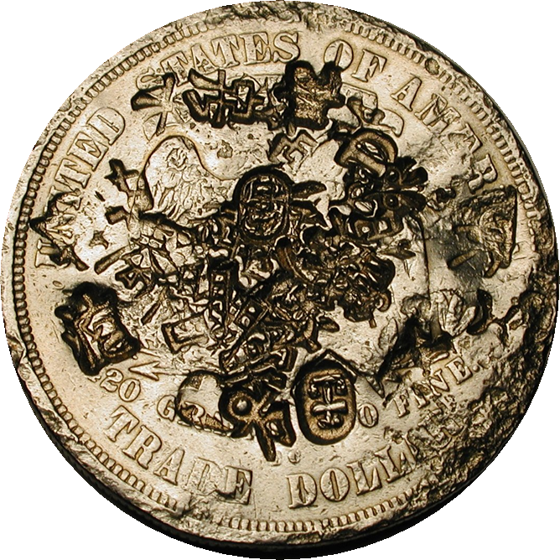
Chop marks
Once a coin had a few chops, most merchants just accepted it
However, sometimes people just started piling on!
1874-CC, 40+ chops
Notes:
Once a coin had several chops, most of the time subsequent takers of the coin did not necessarily feel the need to add additional chops.
ANIMATION…
However, a few pieces can be found with many dozens of chops, almost mutilating the coin.
ANIMATION…

Slide 29
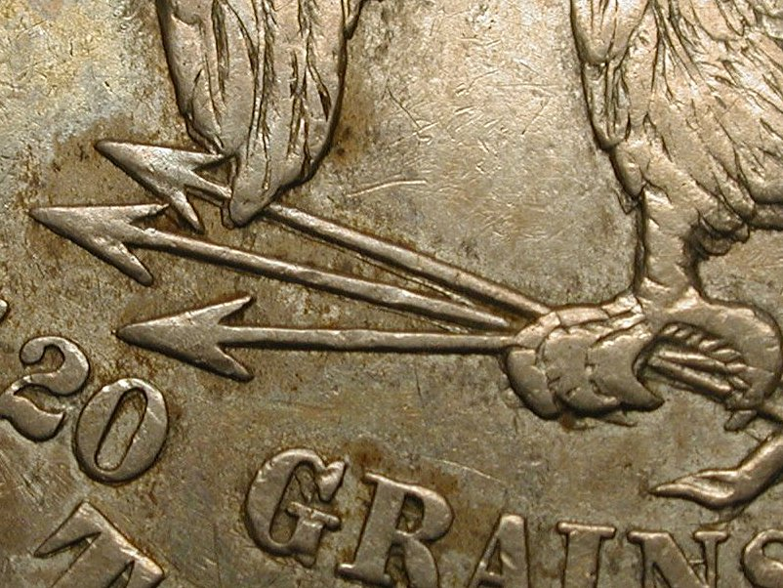

Popular major variety: 1876-CC DDR
Scarce, but always seems to be available
One of the widest doubled dies known
A number of other varieties are much rarer
This one is popular, because it can be found
Notes:
There are a number of varieties within the Carson City Trade dollars, but one of them is very popular and highly collected, the 1876-CC Doubled Die Reverse.
This is one of the widest doubled dies known, with the most extensive doubling on the olive branch on the right side. The eagle’s wing is also very evident.
On the left side, minor doubling in the arrows can be seen.
Although there are other varieties that are rarer, this one is popular because of its magnitude, and also because it can be easily found.

Slide 30








Trade Dollar Sub-types
Type I
Type I
Type II
Type II
Ribbon tips direction
Number of fingers
Inside of right claw
Arrow and 420 position
Note:
Notes:
The hub changes in both obverse and reverse dies were minor, but the differences between Type I and Type II dies are easy to identify.
Obverses:
- Type I has ribbon end short and stubby, and bent to the left.
Liberty’s hand only has 3 fingers below the stem
- Type II has longer ribbon ends, and they hang straighter
Liberty’s hand has 4 fingers visible below the stem
Reverses:
- Type I features a berry in the gap between the Eagle’s claw
Arrow’s point is between 2 and 0 in “420”
- Type II omits the berry, and there is clear space within the claw
Arrow’s point is over the center of the 2 in “420”

Slide 31
Trade Dollar hub combinations
Overlaps among 1875 and 1876 issues
Type I / I | Type I / II | Type II / II
1873CC 1874CC 1875CC | 1875CC 1876CC | 1877CC 1878CC
Notes:
This chart shows the uses of the different hubs for Carson City Trade Dollars. In 1875, coins can be found with two different hub combinations, both with Type I obverse, and using both reverse hubs (I/I and I/II). By 1877, the newer Type II hubs were used for both obverse and reverse.

Slide 32
Summary
Carson City Liberty Seated silver coins from 1870 to 1878 are very widely collected
Many of the early issues 1870-1874 have small mintages and most are scarce to rare today
Obtaining the early coins in original and problem-free condition is very difficult
Many problem pieces are third-party graded as “market acceptable” but command far less than choice pieces
Two 1873-CC No Arrows issues are uncollectable
Notes:
In Summary,
Liberty Seated coins were minted in Carson City during the years 1870-1878.
The early years for most series feature the smallest mintages, and result in many scarce to rare issues
Most of the early coins have problems of some sort, and choice problem-free original coins are very rare
The third-party grading services have graded many of these problem coins as “market acceptable” but these coins bring far less than the very rare choice pieces in the market
Two uncollectible issues reside in the Dimes and Quarters, both of them 1873-CC No Arrows coins.

Slide 33
www.LSCCweb.org
Thank you!
Any questions?

